Slide 1



International Students & Staff Affairs
01
KONU GİRİŞ SAYFASI
International Student & Staff Affairs
ISSA

Slide 2
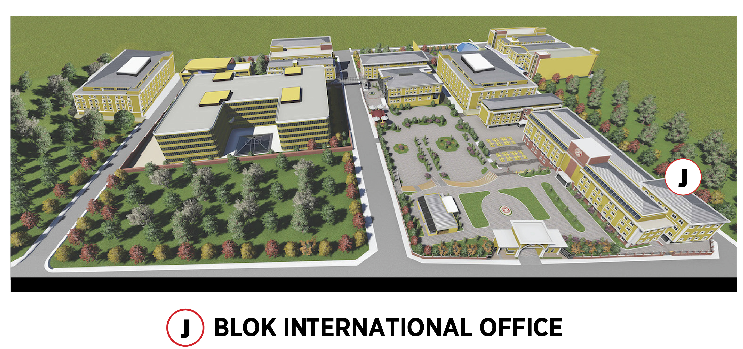
Where is ISSA Office?
International Students & Staff Affairs
02
KONU GİRİŞ SAYFASI

Slide 3
What do we do?
International Students & Staff Affairs
03
KONU GİRİŞ SAYFASI
Activities
Programs
Projects
Student Services

Slide 4
Student Services
International Students & Staff Affairs
4
KONU GİRİŞ SAYFASI
Student Residence Permit
Cultural & Social events
Announcements
Work Placement Guidance
Orientation

Slide 5
Activities
International Students & Staff Affairs
5
KONU GİRİŞ SAYFASI
Coffee Hours
Country Meetings
Tournaments
International Cultural Day
Special Country Days
Other Conference and Seminars
Halloween

Slide 6


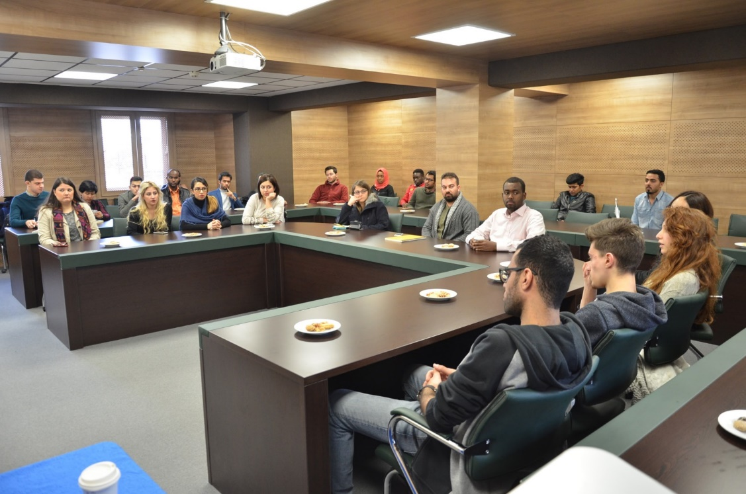
International Students & Staff Affairs
6
KONU GİRİŞ SAYFASI
COFFEE HOURS

Slide 7
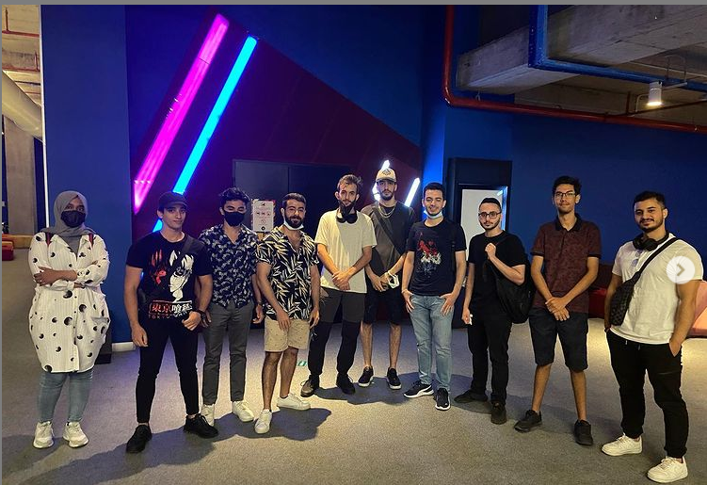
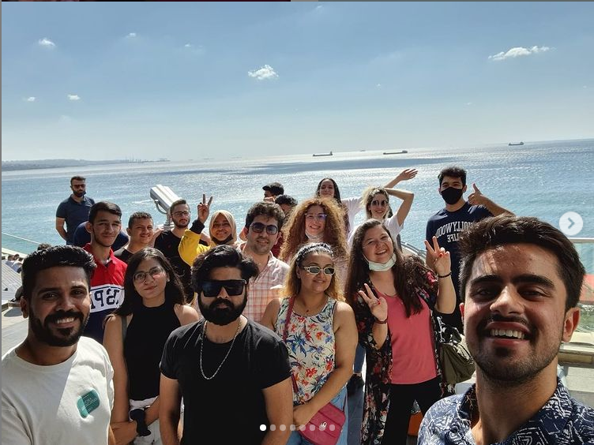
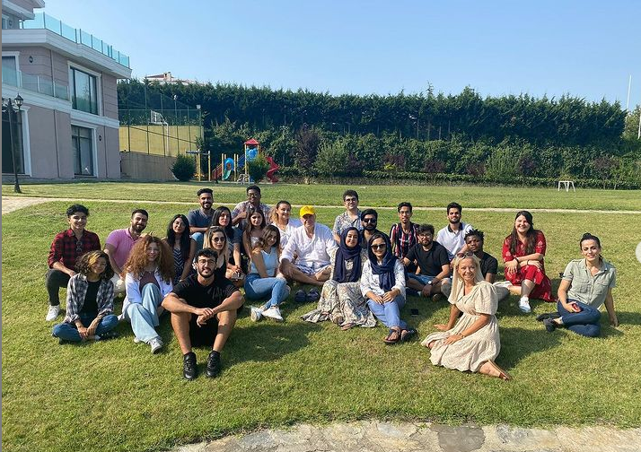
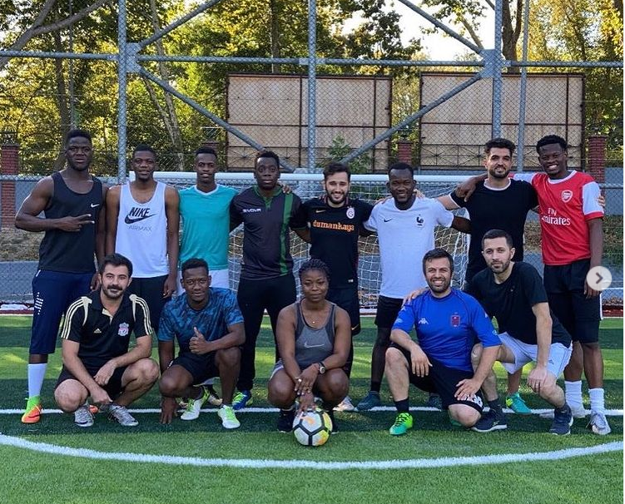
International Students & Staff Affairs
6
KONU GİRİŞ SAYFASI
RECENT EVENTS

Slide 8

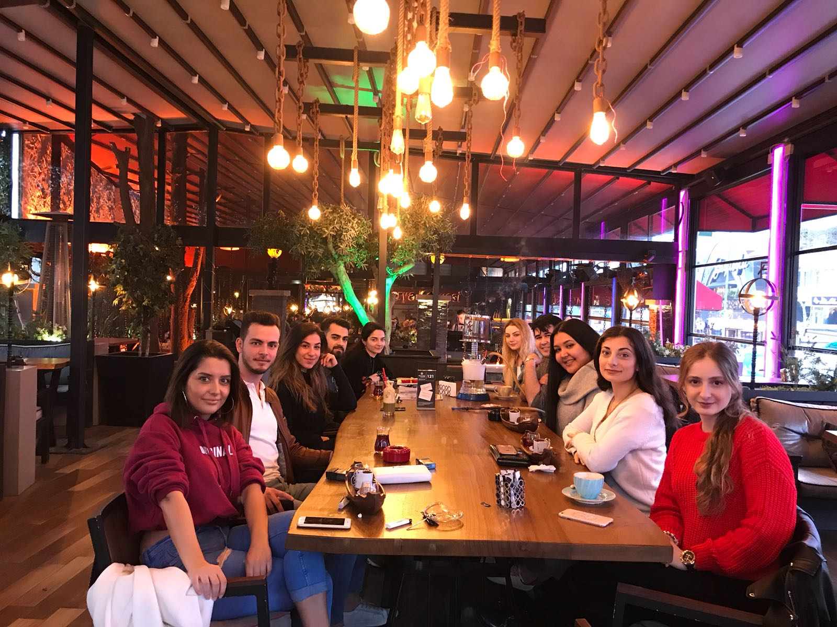
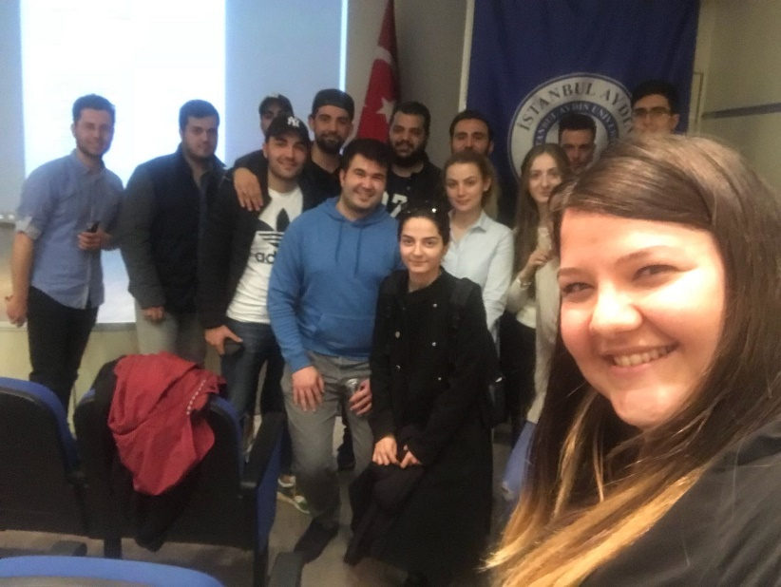
Country Meetings
International Students & Staff Affairs
7
KONU GİRİŞ SAYFASI

Slide 9
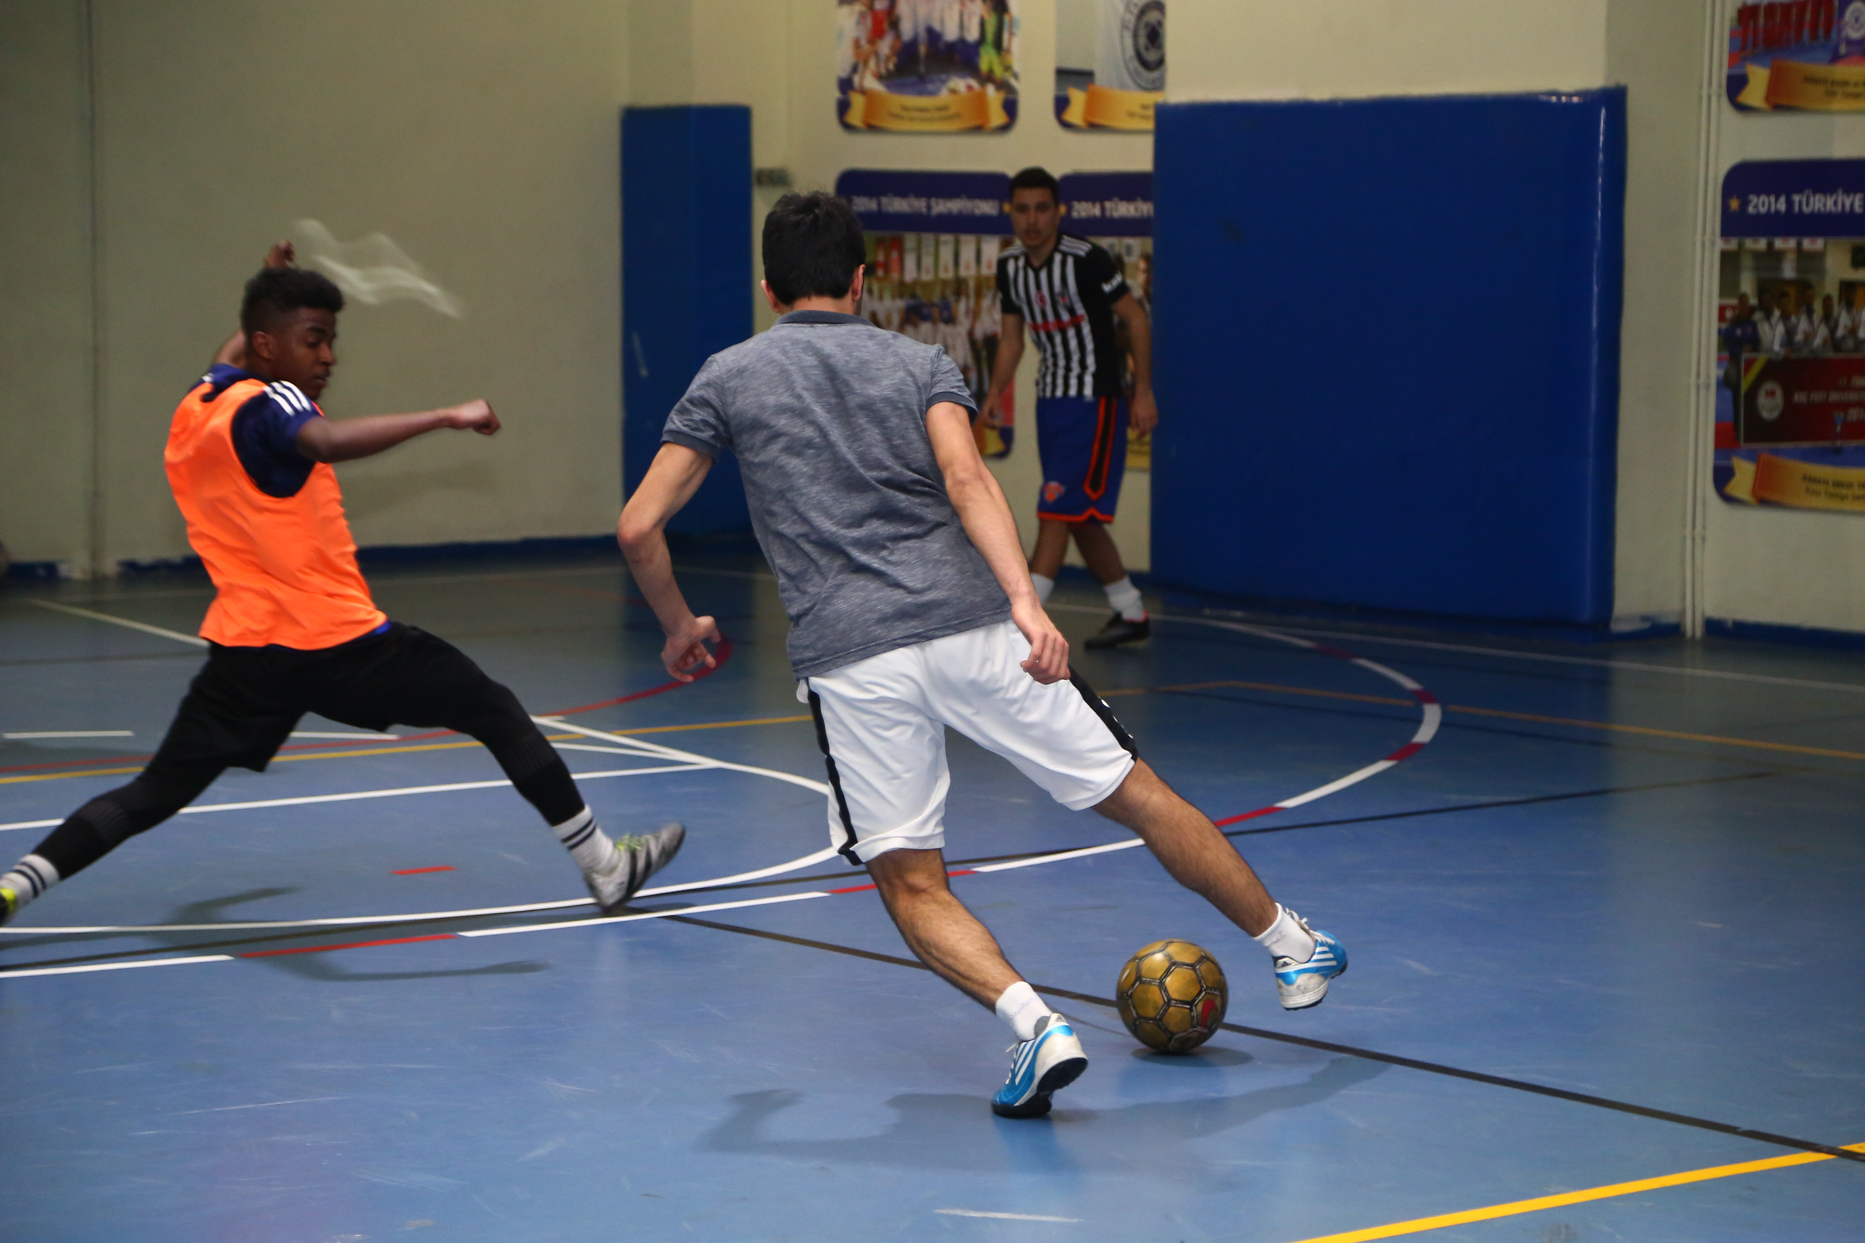
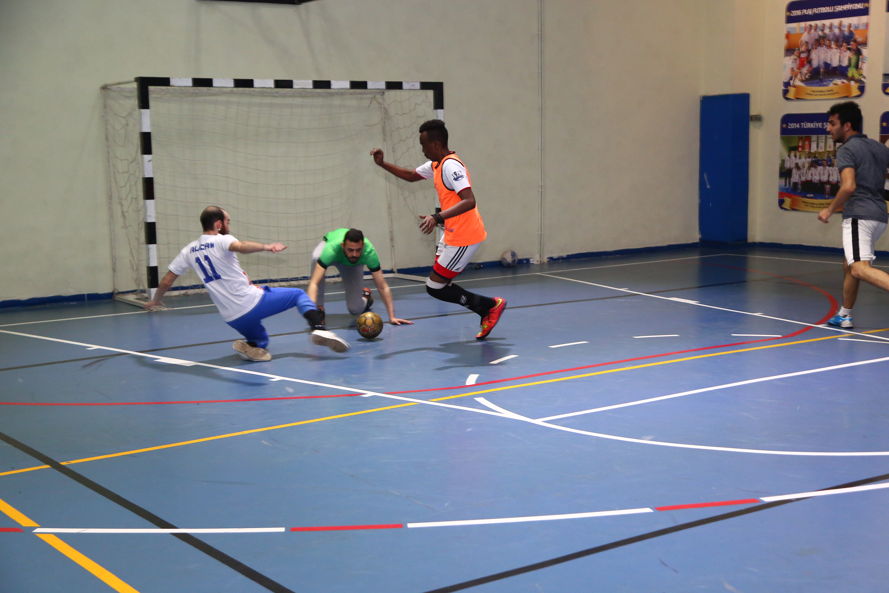
Tournaments
International Students & Staff Affairs
8
KONU GİRİŞ SAYFASI

Slide 10
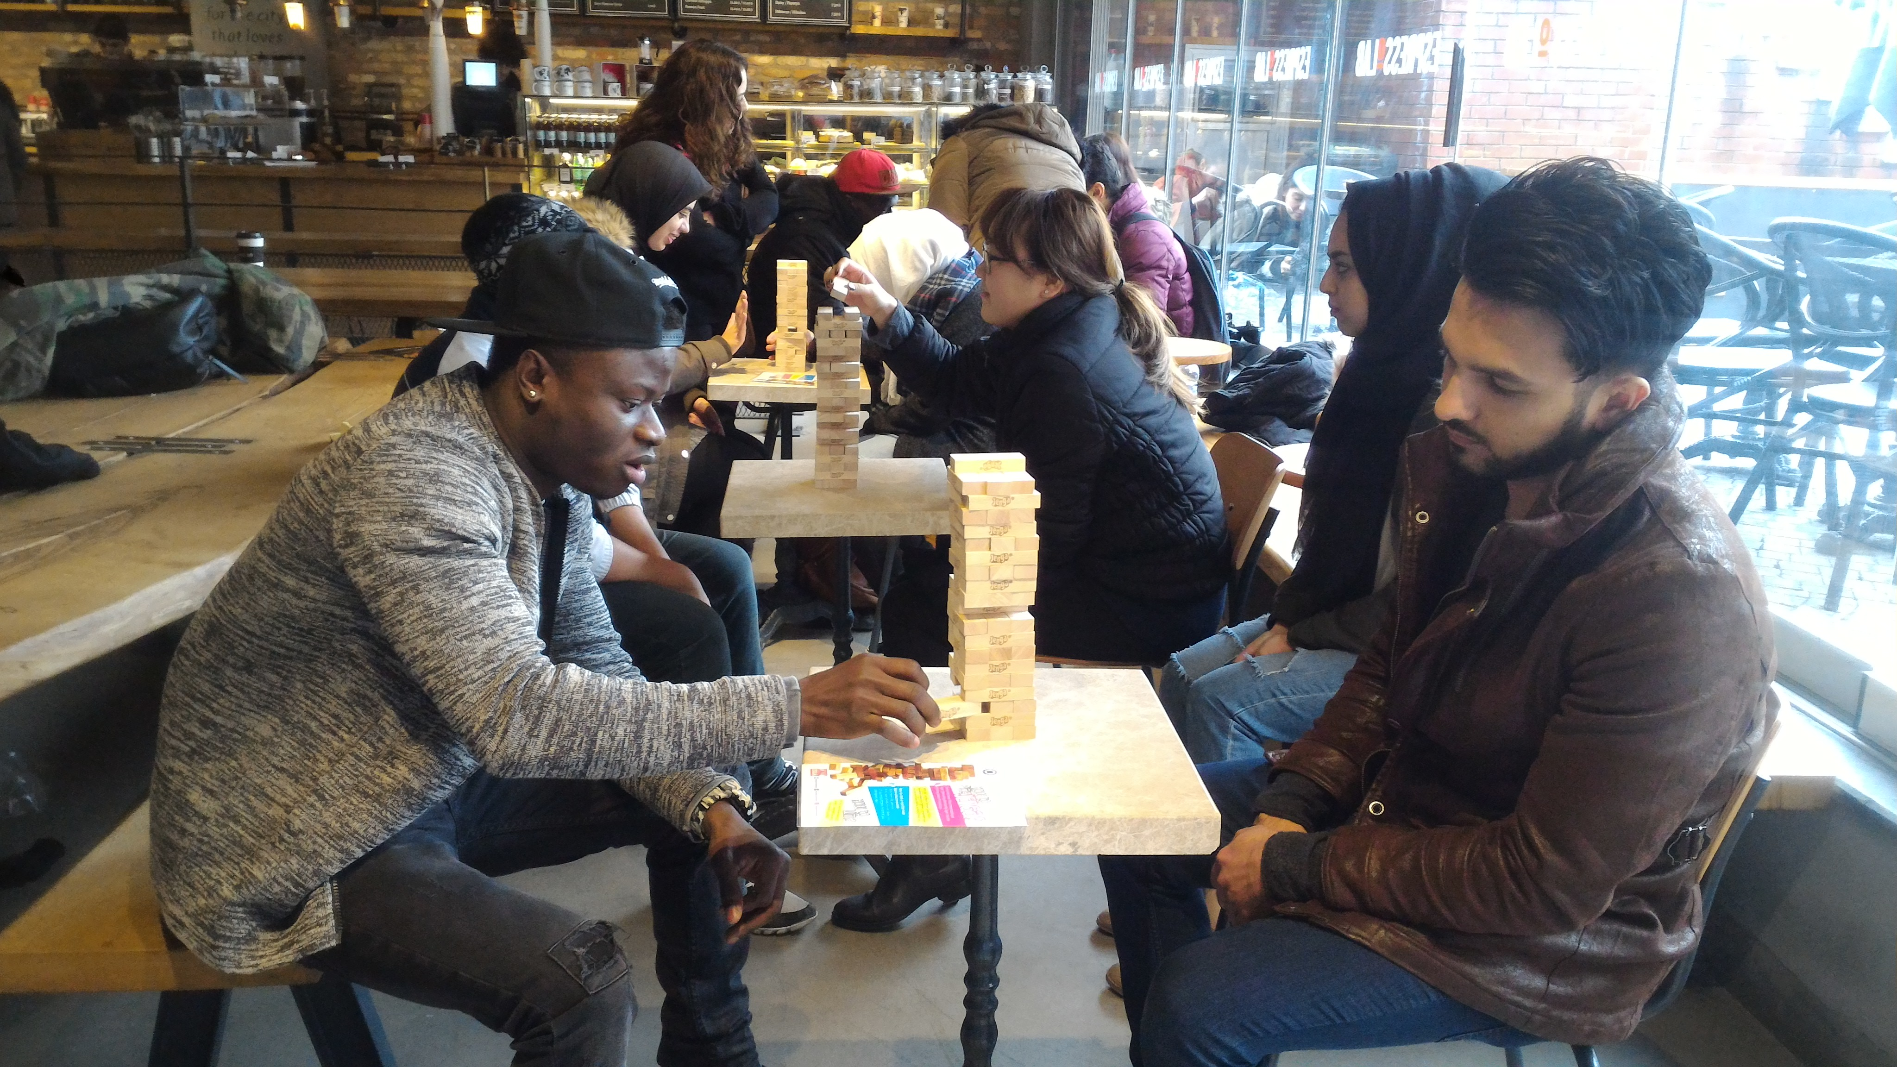
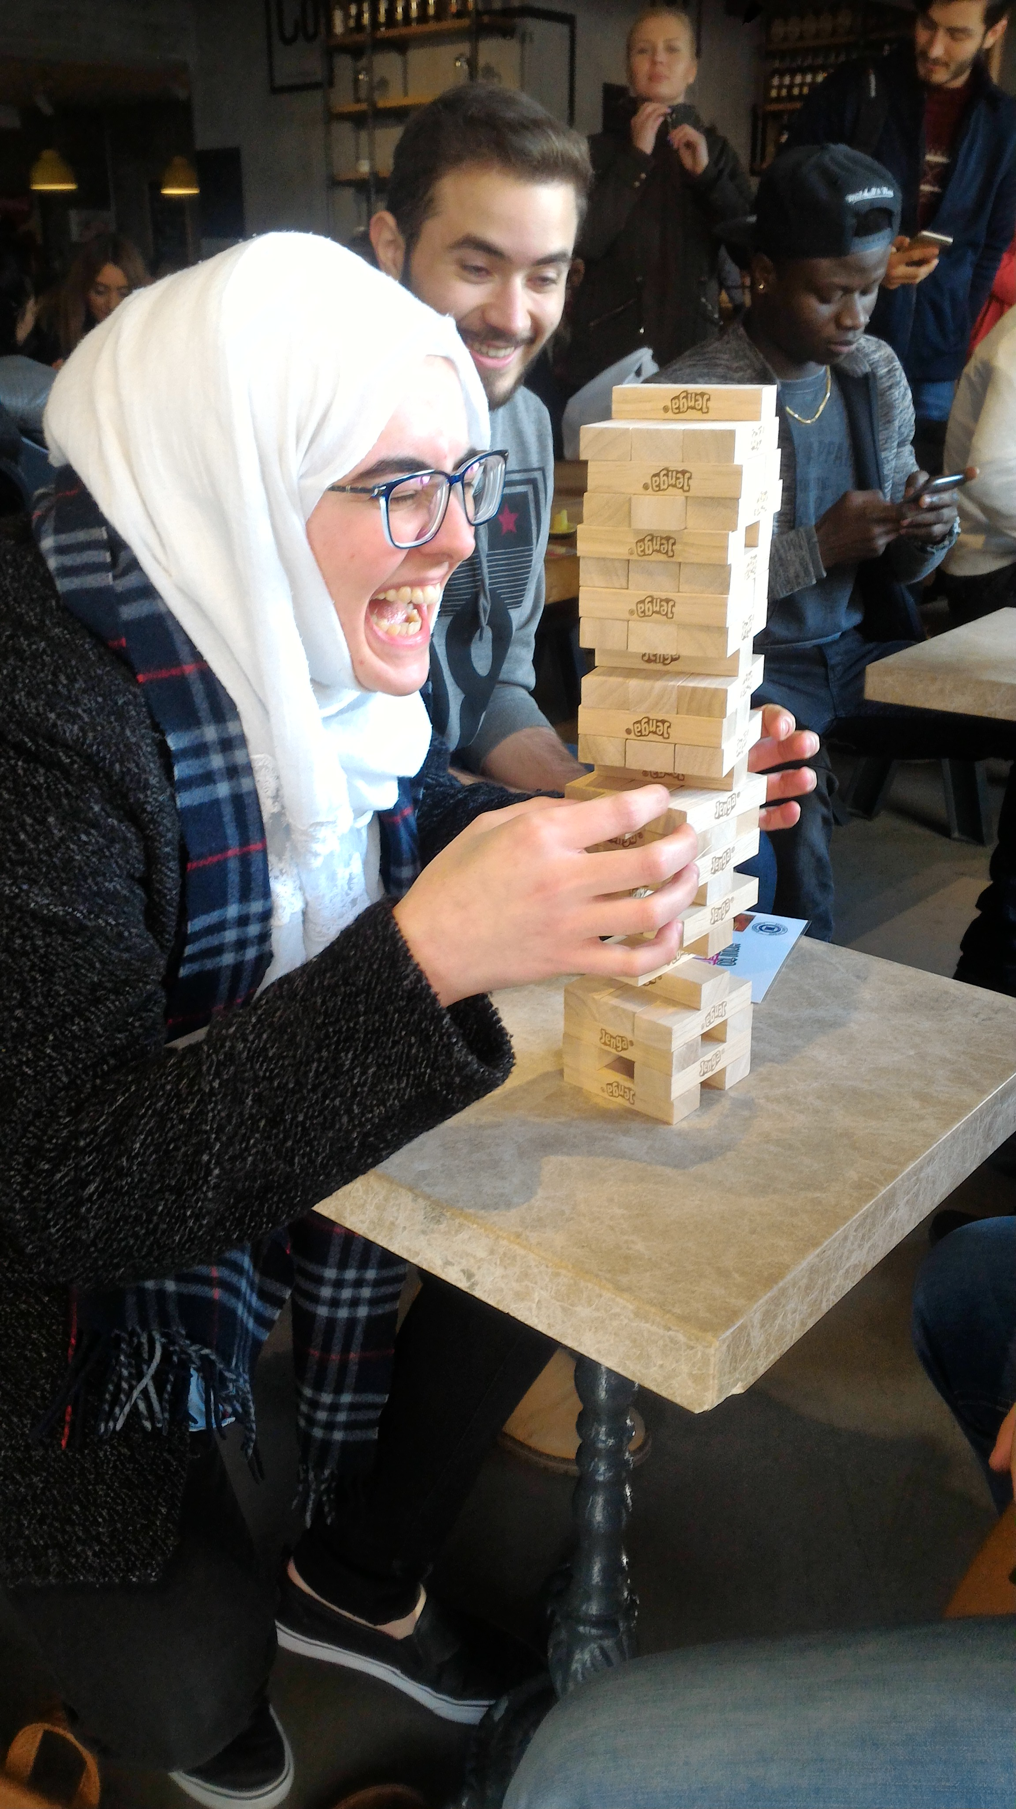
Tournaments
International Students & Staff Affairs
9
KONU GİRİŞ SAYFASI

Slide 11
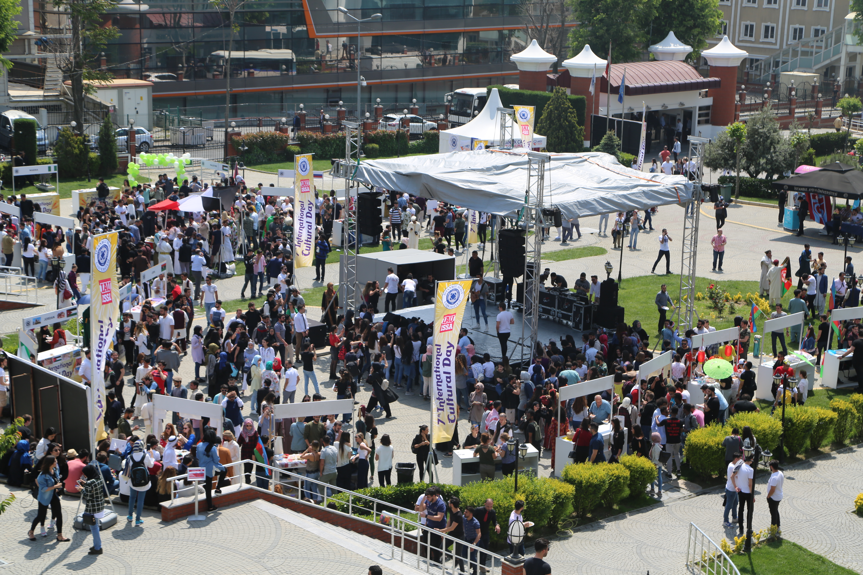
International Cultural Day
International Students & Staff Affairs
13
KONU GİRİŞ SAYFASI

Slide 12
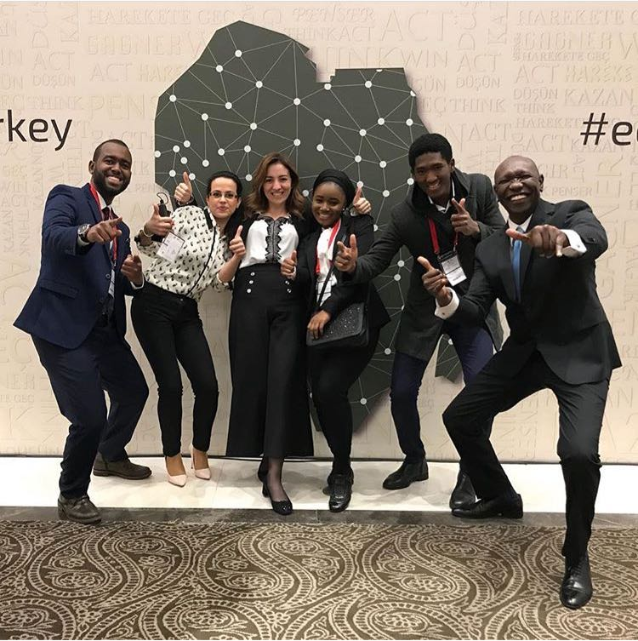
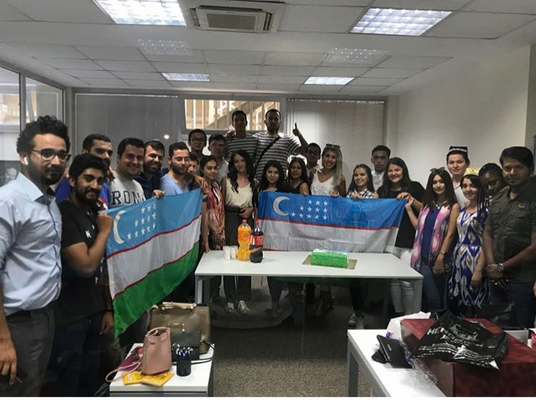
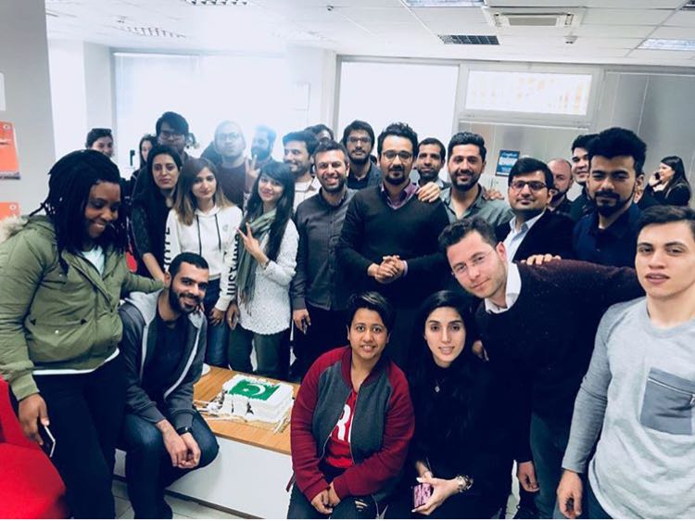
Special Country Days
International Students & Staff Affairs
15
KONU GİRİŞ SAYFASI

Slide 13
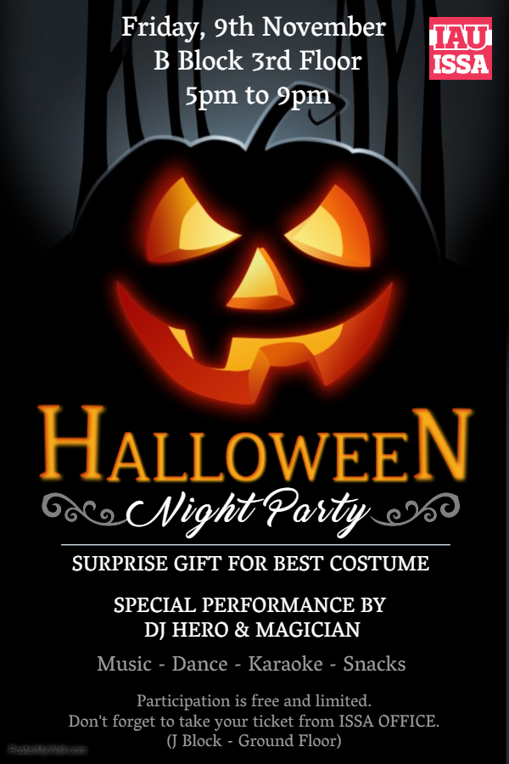
HALLOWEEEN
International Students & Staff Affairs
17
KONU GİRİŞ SAYFASI

Slide 14
PROGRAMS
International Students & Staff Affairs
21
KONU GİRİŞ SAYFASI
Volunteer Student Program
International Student Union (ISU)

Slide 15
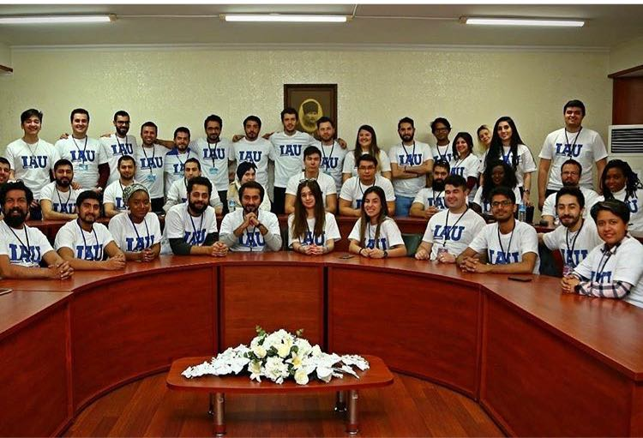
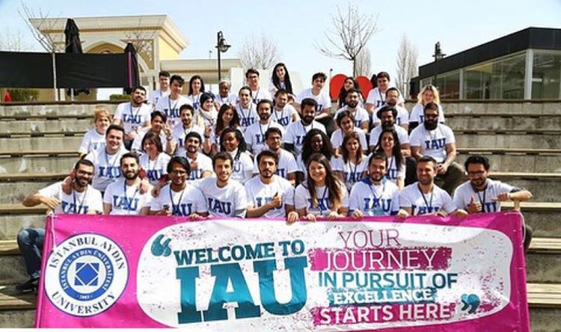
Volunteer Student Program
International Students & Staff Affairs
22
KONU GİRİŞ SAYFASI

Slide 16

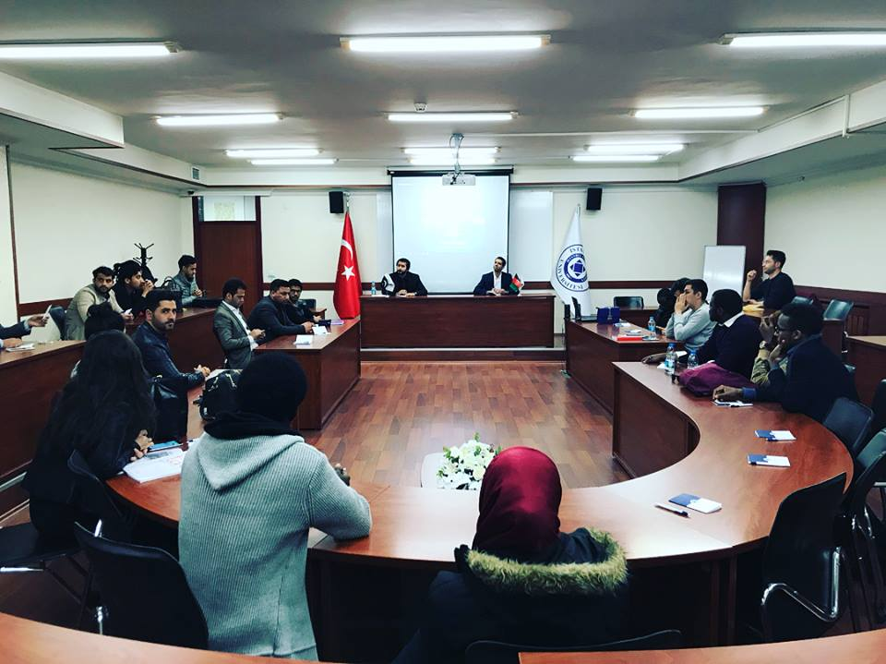
International Student Union (ISU)
International Students & Staff Affairs
23
KONU GİRİŞ SAYFASI

Slide 17

International Student Union (ISU)
International Students & Staff Affairs
23
KONU GİRİŞ SAYFASI

Slide 18
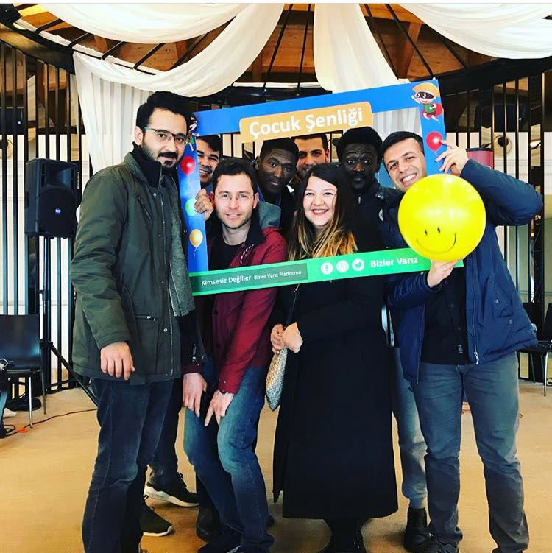
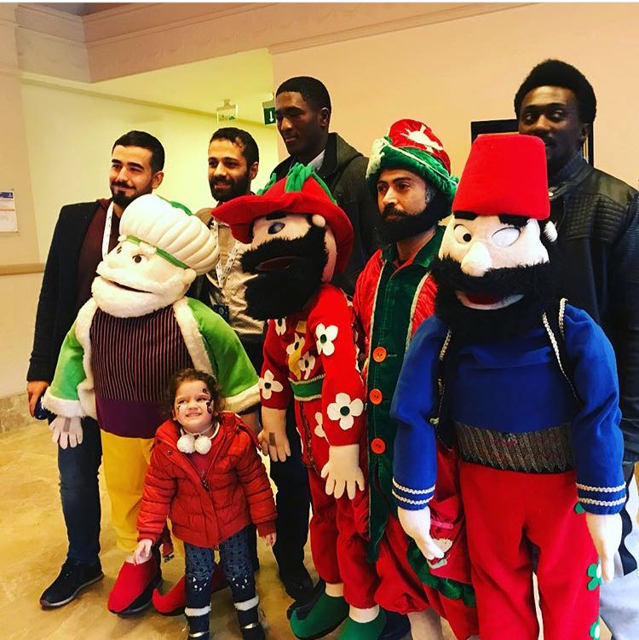
Social Responsibility Projects
International Students & Staff Affairs
25
KONU GİRİŞ SAYFASI

Slide 19
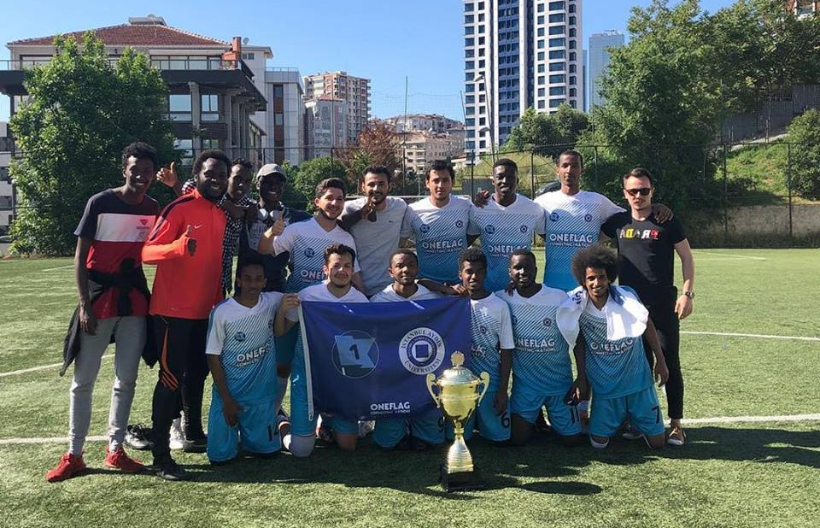
International Students & Staff Affairs
26
KONU GİRİŞ SAYFASI
IAU – International Student Football Team

Slide 20


PUBLISHMENTS
International Students & Staff Affairs
27
KONU GİRİŞ SAYFASI
RESIDENCE PERMIT GUIDE
STUDENT GUIDE
E-BULLETIN

Slide 21
ACADEMIC CALENDAR
International Students & Staff Affairs
28
KONU GİRİŞ SAYFASI
2021-2022 ACADEMIC YEAR the complete academic calendar is also available on UBIS | 2021-2022 ACADEMIC YEAR
 | FALL TERM | SPRING TERM
Course Registration Period | 21.09.2021 - 29.09.2021 | 8.02.2022 - 16.02.2022
Orientation | 27.09.2021 - 01.10.2021
Begining of Courses | 27.09.2021 | 14.02.2022
Deadline for Course Exemption Application | 01.10.2021 | 18.02.2022
Course Add-drop Week | 04.10.2021 - 08.10.2021 | 21.02.2022 - 25.02.2022
Mid-term exams | 20.11.2021 - 27.11.2021 | 09.04.2022 - 17.04.2022
Last Day of the Classes | 08.01.2022 | 03.06.2022
Final Exams | 10.01.2022 - 22.01.2022 | 06.06.2022-18.06.2022
Make-Up for Final Exams | 31.01.2022 - 05.02.2022 | 27.06.2022-03.07.2022

Slide 22
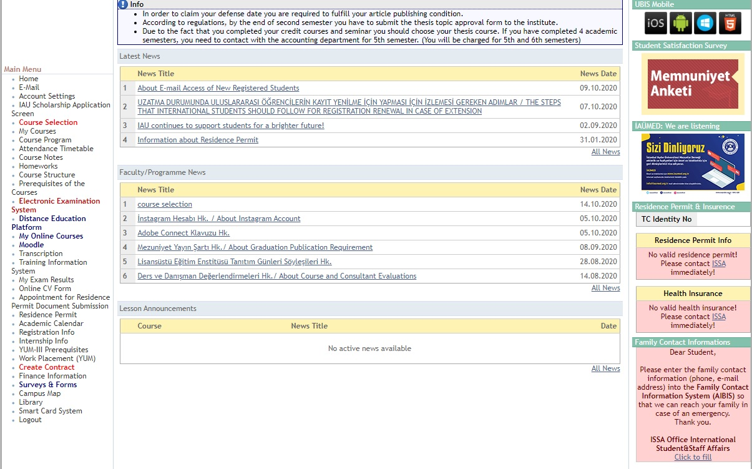
UBIS- STUDENT ELECTRONIC ACCOUNT
International Students & Staff Affairs
28
KONU GİRİŞ SAYFASI

Slide 23
International Students & Staff Affairs
28
KONU GİRİŞ SAYFASI
HOW TO OBTAIN HES CODE?
You can get information about how to obtain HES Code from hayatevesigar.saglik.gov.tr website of Ministry of Health.
Hayat Eve Sığar Application (IOS and Android)
Through Hayat Eve Sığar Application, enter into “HES Kodu İşlemleri” section. Click “HES Kodu Oluştur” button.
Choose code usage period and create the code.

Slide 24
International Students & Staff Affairs
28
KONU GİRİŞ SAYFASI
HOW TO OBTAIN HES CODE?
For newly registered students
2. Via SMS to 2023
For students with bluea card or ID number starting with 97,98,99;
Write “HES”, and leave a space, respectively write ID number and the last 4 digits of ID card’s serial number, year of birth and sharing time (days). And send the SMS to 2023.
Example: Write HES 12345678901 1232 1995 45 and send to 2023
*Students who do not have ID number or foreigner ID number; with passport information, write “HES” and leave a space, respectively write Nationality, Passport serial Number, Year of Birth and Last Name, and send to 2023

Slide 25
International Students & Staff Affairs
28
KONU GİRİŞ SAYFASI
HOW TO OBTAIN HES CODE?
For students who have Turkish Residence permit
3. Via e-Devlet application
You can take HES Code from
www.turkiye.gov.tr/saglik-bakanligi-hes-kodu-uretme-ve-listeleme
on E-Devlet system.

Slide 26
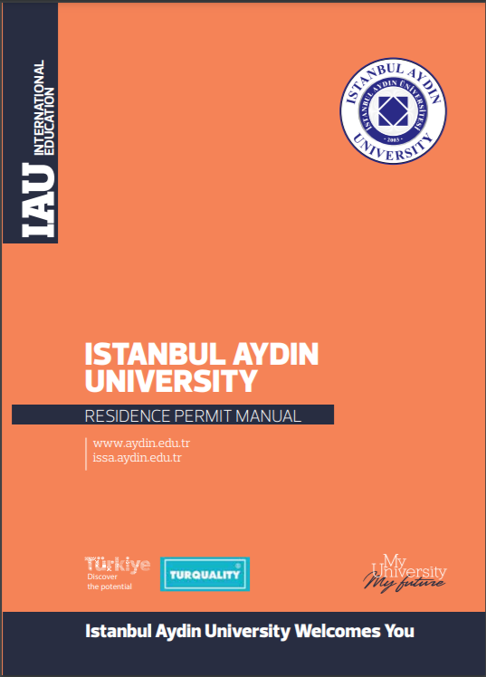
International Students & Staff Affairs
28
KONU GİRİŞ SAYFASI
RESIDENCE PERMIT
According to the new protocol between the Council of Higher Education and the Ministry of Interior in Turkey, all international students are obligated to submit their required documents for the student residence permit to International Student and Staff Affairs (ISSA Office) after they completed their residence permit applications
within 30 days of entering Turkey.
Find out how to apply by checking our Residence permit application guide: https://www.aydin.edu.tr/en-us/international/issa/Documents/ikamet%20rehberi.pdf

Slide 27
International Students & Staff Affairs
28
KONU GİRİŞ SAYFASI
Frequently Asked Questions
You can receive your Student Letter and Transcript from T block –Students Affairs Office
You can receive your Student Card from D block IT Department
You can apply for transportation card from any IETT branch with a student letter, a photo and the residence permit. Rember to match your transportation card with your HES code via: https://kisisellestirme.istanbulkart.istanbul/
Students can take the museum card and visit the museums in Istanbul from major museum entrances (e.g. Topkapı Palace entrance). For more information: https://muze.gov.tr/MuseumPass

Slide 28


Social Media Accounts
International Students & Staff Affairs
28
KONU GİRİŞ SAYFASI
iauissa

