Slide 1


2014-2015 ERASMUS STAJ HAREKETLİLİGİ
ORYANTASYON PROGRAMI
25.04.2014

Slide 2

ERASMUS STAJ HAREKETLİLİĞİ
YAPILMASI GEREKENLER
THINGS TO DO FOR ERASMUS PLACEMENT
MOBILITY

Slide 3
About European Commission – Turkish National Agency
The European Commission is ultimately responsible for the running of the Erasmus+ Programme. It manages the budget and sets priorities, targets and criteria for the Programme on an on-going basis
At European level, the European Commission's Education, Audiovisual and Culture Executive Agency (Executive Agency) is responsible for the implementation of the centralised Actions of the Erasmus+ Programme.
About TR National Agency: The European Commission is responsible for the overall implementation of Erasmus Programme. Actions are managed by national agencies in the participating countries or by Executive Agency for Education, Audovisiual and Culture based in Brussels. Centre for EU Education and Youth Programmes - Turkish National Agency promotes and implements the Programme at national level and acts as the link between the European Commission and participating organisations at local, regional and national level.

Slide 4
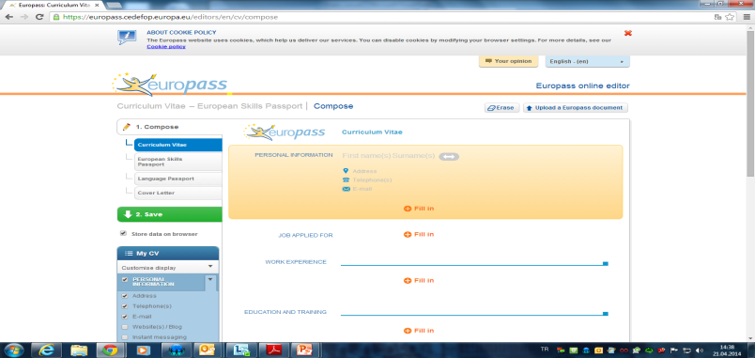
ÖNCE
BEFORE
EUROPASS CV HAZIRLANMASI
PREPARING EUROPASS CV
https://europass.cedefop.europa.eu/editors/en/cv/compose

Slide 5
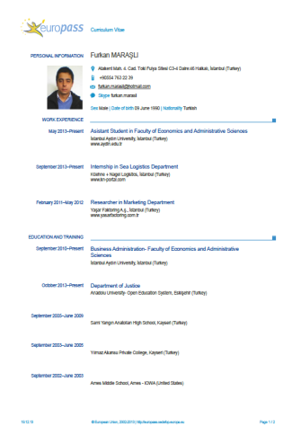
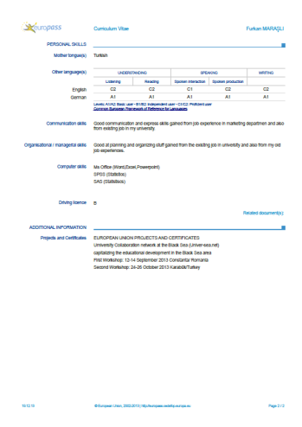
ÖNCE
BEFORE

Slide 6
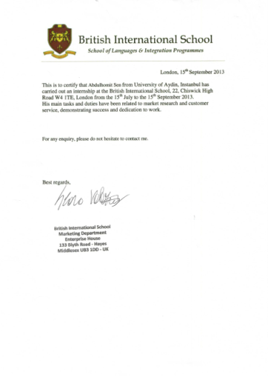
ÖNCE
BEFORE
Davet Mektununun temin edilmesi.
Receiving Invitation Letter

Slide 7
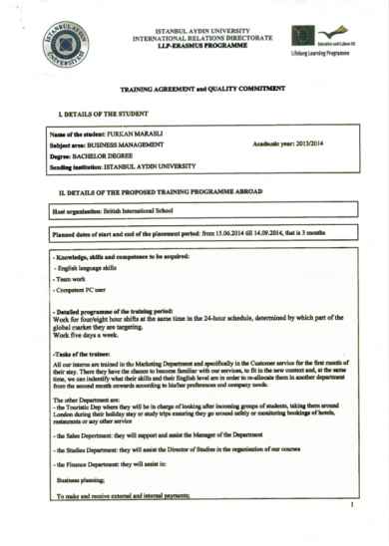
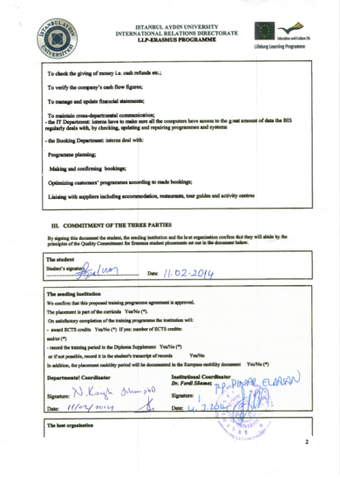
ÖNCE
BEFORE
Staj Anlaşmasının hazırlanması.
Preparing Training Agreement

Slide 8
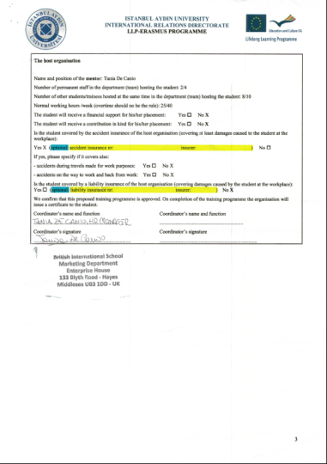
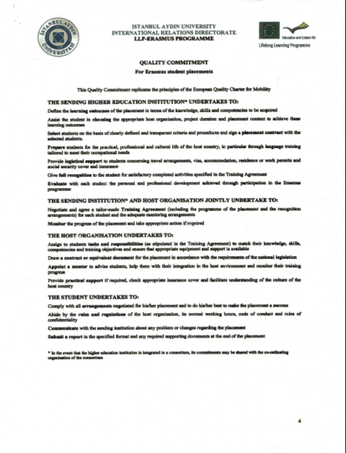
ÖNCE
BEFORE

Slide 9
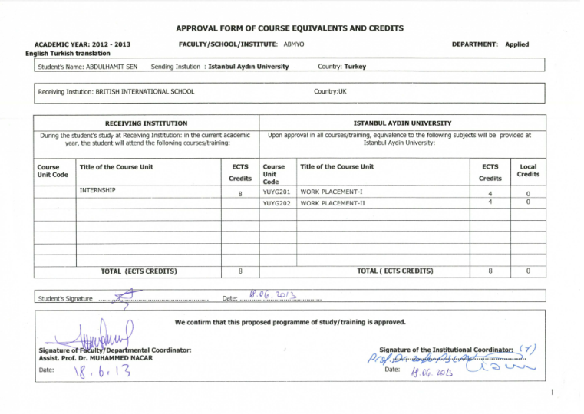
Tanınırlık Formunun hazırlanması.
Preparing Approval Form
ÖNCE
BEFORE

Slide 10
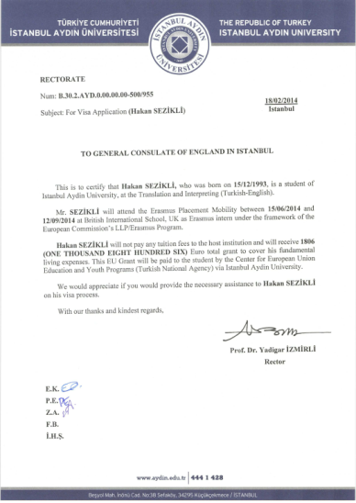
Vize Yazısının Erasmus Ofisinden Temin Edilmesi
Receiving Visa Letter from IAU Erasmus Office
ÖNCE
BEFORE

Slide 11

İNGİLTERE İÇİN VİZE SÜRECİ
VISA PROCESS FOR UK

Slide 12
CoS Numarası İçin Gerekli Belgelerin Tamamlanması
Completing Necessary Documents to Get CoS Number
Fill the Form and send it to egemenkir@aydin.edu.tr

Slide 13

CoS Numarası İçin Gerekli Belgelerin Tamamlanması
Completing Necessary Documents to Get CoS Number
Unconditional Intern Visitor Visa Letter
All Pages of Passport MUST be Scanned

Slide 14
CoS Numarası İçin Gerekli Belgelerin Tamamlanması
Completing Necessary Documents to Get CoS Number
Visa Application Letter from Rectorate
Training Agreement

Slide 15
Orijinal CoS Numarası Formunun Temin Edilmesi
Receiving Original CoS Number Form

Slide 16
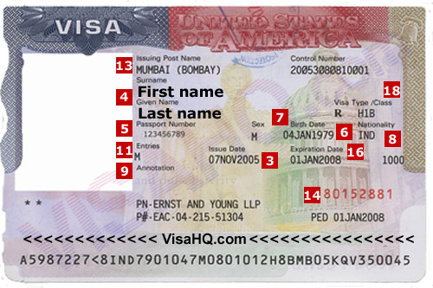
ÖNCE
BEFORE
Vize Sürecinin Tamamlanması
Completing Visa Application Process

Slide 17
ERASMUS STAJ ÖDEMESİ İÇİN YAPILMASI GEREKENLER – THINGS TO DO FOR YOUR ERASMUS INTERNSHIP PAYMENT
ÖNCE
BEFORE
HSBC BANKASINDAN EURO HESABI AÇTIRMALISINIZ | YOU NEED TO HAVE AN EURO ACCOUNT ON HSBC BANK
DAHA SONRA BANA ULAŞARAK HİBE SÖZLEŞMESİ YAPMALISINIZ | THEN YOU HAVE TO REACH ME TO SIGN THE CONTRACT

Slide 18
ÖDEME SÜRECİ – PAYMENT PROGRESS
ÖNCE
BEFORE
GİDECEĞİNİZ ÜLKEYE GÖRE ÖDEME MİKTARLARI FARKLILIK GÖSTERMEKTEDİR. | DIFFERENCES MAY OCCUR ON YOUR PAYMENT ACCORDING TO YOUR DESTINATION
GİTMEDEN ÖNCE ÖDEMENİZİN %80’LİK KISIM, DÖNÜŞTE İSE KALIŞ SÜRENİZE GÖRE KALAN %20’LİK ÖDEMENİZ HESABINIZA YATAR. | BEFORE YOU LEAVE YOU GET %80 OF YOUR PAYMENT AND AFTER YOUR RETURN YOU GET YOUR %20 PAYMENT ACCORDING TO TIME OF YOUR STAY.
2 YILLIKLARDA VİZE VE ULAŞIM ÜCRETLERİNİN %75’İ ÖDENMEKTEDİR | %75 OF YOUR VISA AND TRAVEL EXPENSES WILL BE PAID IF YOU STUDIED 2 YEARS IN OUR UNIVERSITY

Slide 19
DÖNDÜKTEN SONRA TESLİM EDİLMESİ GEREKEN BELGELER – NECESSARY DOCUMENTS AFTER YOUR ARRIVAL
SONRA
AFTER
KATILIM SERTIFIKASI | CERTIFICATE
NİHAİ RAPOR | FINAL REPORT
PASAPORT GİRİŞ ÇIKIŞ DAMGALARI OLAN SAYFALARIN FOTOKOPİLERİ | COPY OF YOUR PASSPORT PAGES WHICH HAVE ENTRANCE AND EXIT STAMPS
2 YILLIKLAR İÇİN UÇUŞ ÜCRETİNİ GÖSTEREN BELGE, UÇUŞ KARTLARI, VİZE ÜCRETİNİ GÖSTEREN BELGE | FOR THE STUDENTS WHO STUDIED 2 YEARS IN OUR UNIVERSITY, BILLS FOR FLIGHT TICKETS, BOARDING PASSES, BILLS FOR VISA

Slide 20
GRANTS FOR STUDENT MOBILITY
GROUP 1 MAXIMUM 250-500 EUROS/MONTH | GROUP 2 200-400 EUROS/MONTH | GROUP 3 150-400 EUROS/MONTH
Program Countries with higher living costs: Denmark, Ireland, France, Italy, Austria, Finland, Sweden, United Kingdom, Liechtenstein, Norway, | Program Countries with medium living costs: Belgium, Czech Republic, Germany, Greece, Spain, Croatia, Cyprus, Luxembourg, Netherlands, Portugal, Slovenia, Iceland, Turkey | Program Countries with lower living costs: Bulgaria, Estonia, Latvia, Lithuania, Hungary, Malta, Poland, Romania, Slovakia, former Yugoslav Republic of Macedonia
Switzerland
Internship: Student mobility grants + 100-200 Euros monthly

Slide 21
ÖĞRENİM HAREKETLİLİĞİ
HİBE MİKTARLARI
1. GRUP AYLIK MAKSIMUM 500 AVRO | 2. GRUP AYLIK 250-450 AVRO | 3. GRUP AYLIK MİNİMUM 150 AVRO
YAŞAM HARCAMALARI YÜKSEK ÜLKELER, DANİMARKA, İRLANDA, FRANSA, İTALYA, AVUSTURYA, FİNLANDİYA, İSVEÇ, İNGİLTERE, LİHTENŞTAYN, NORVEÇ | YAŞAM HARCAMALARI ORTA SEVİYE ÜLKELER, BELÇİKA, ÇEK CUMHURİYETİ, ALMANYA, YUNANİSTAN, İSPANYA, HIRVATİSTAN, GÜNEY KIBRIS, LÜKSEMBURG, HOLLANDA, PORTEKİZ, SLOVENYA, İZLANDA, TÜRKİYE | YAŞAM HARCAMALARI DAHA DÜŞÜK ÜLKELER, BULGARİSTAN, ESTONYA, LETONYA, LİTVANYA, MACARİSTAN, MALTA, POLONYA, SLOVAKYA, ROMANYA, MAKEDONYA
İSVİÇRE
Staj için hibe miktarı: Öğrenim Hareketliliği Hibeleri + 100-200 Avro/Ay

Slide 22
BİRİNCİ ÖDEME İÇİN GEREKLİ OLAN BELGELER – DOCUMENTS FOR YOUR FIRST PAYMENT
ÖNCE
BEFORE
KABUL MEKTUBU FOTOKOPİSİ | COPY OF ACCEPTANCE LETTER
VİZE FOTOKOPİSİ | COPY OF YOUR VISA
TRAINING AGREEMENT | TRAINING AGREEMENT
HİBE SÖZLEŞMESİ | CONTRACT

Slide 23
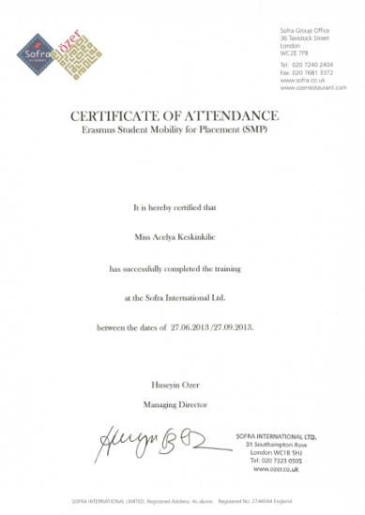
Katılım Sertikasının Temin Edilmesi
Recieving Certificate of Attendance from Host Institution
SONRA
AFTER

Slide 24
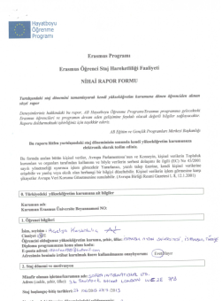


SONRA
AFTER
Evrakların Erasmus Ofisine teslim edilmesi
Delivering the Documents to IAU Erasmus Office
Nihai Rapor
Final Report
Giriş-Çıkış
Departure & Arrival Date
Katılım Sertifikası
Certificate of Attendance

Slide 25
Contact Us – Join Us Online
For further inquiries please don`t hesitate in contacting us at: erasmus@aydin.edu.tr
Or via:
Twitter: https://twitter.com/iauerasmus
Facebook : https://www.facebook.com/iauerasmusoffice

Slide 26
THANKS FOR YOUR ATTENDANCE!
KEEP CALM AND ENJOY ERASMUS! ☺

